Slide 1

Signals and Systems
Lecturer: Dr. Lin Xu (徐林)
Office: 2-302I, SIST
Email: xulin1@shanghaitech.edu.cn
Tel: 20684449

Slide 2
Course Introduction
Motivation
Global content
Exams and grades
Text book and materials
Organization
Pre-knowledge

Slide 3
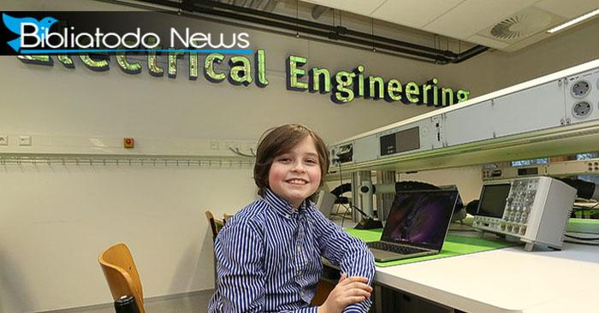

Motivation
Course Introduction
Importance
Confidence
Math is a important but not everything
Focus on big pictures
GPA and real knowledge
Laurent Simons
Rik Vullings

Slide 4
Course Introduction
Global content
Signal (input)
Signal (output)
System
Overview of Signals and Systems
Linear-Time-Invariant Systems
Fourier Series Representation of Periodic Signals
The Continues-Time Fourier Transform
The Discrete-Time Fourier Transform
Time and Frequency Characterization of Signals and Systems
Sampling
The Laplace Transform
The Z-Transform

Slide 5
Exams and Grades
Course Introduction
Homework: 20%
Mid-term (written, close-book): 30%
Final Exam (written, close-book): 50%
All in English, otherwise the grade reduced by 0.8
-5 per absence
Plagiarism: zero

Slide 6
Text book and materials
Course Introduction
Book
Signals and Systems (2nd Edition), by A. V. Oppenheim, A. S. Willsky, and S. Hamid. ISBN: 978-0138147570.
Signals and Systems using Matlab (2nd Edition), by Luis Chaparro. ISBN: 978-0123948120.
These slides
All materials bill be available in the BB system

Slide 7

Organization
Course Introduction
Lecture: week 1-16; teaching center 301; Tue. and Thu. 08:15-10:00
Exercise: time and location TBD
Office hour: time and location TBD
Experiment: by Dr. Linyan Lu, start from the 3rd week
BB system: Slides and text book
Gradescope: homework release and submission, entry code: JB6PPW
WeChat group: general information

Slide 8
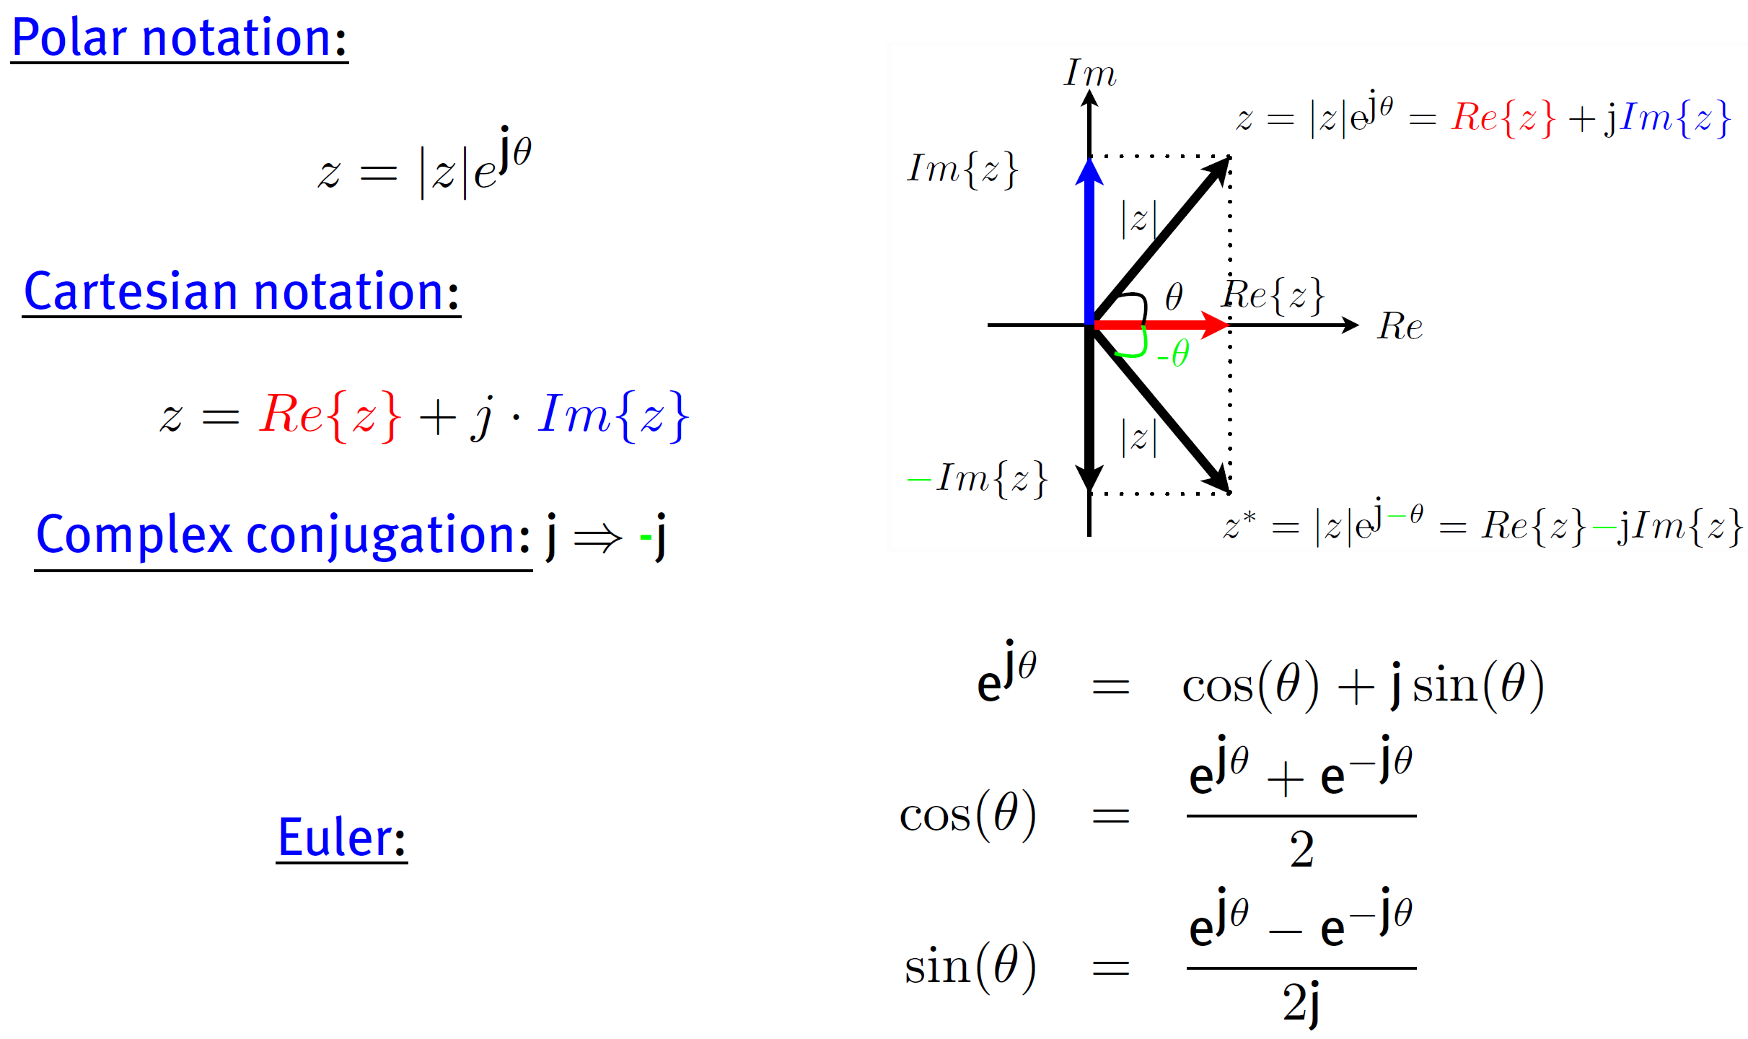
Pre-knowledge: Complex numbers
Course Introduction

Slide 9
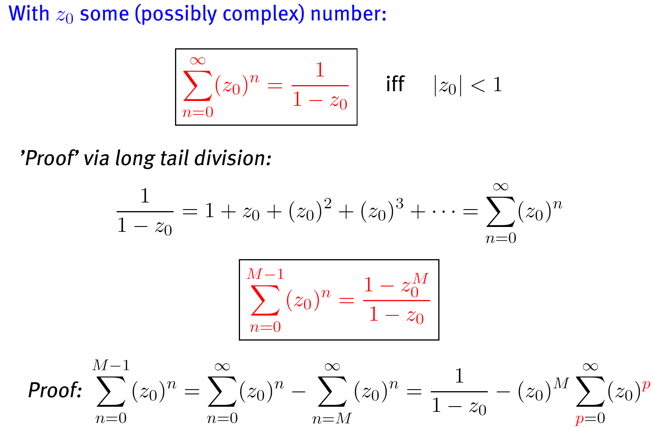
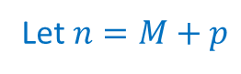
Pre-knowledge: Important geometric series
Course Introduction
Let $n=M+p$
Notes:
Question: why for n=0 to M-1, no requirement of |z|<1

Slide 10
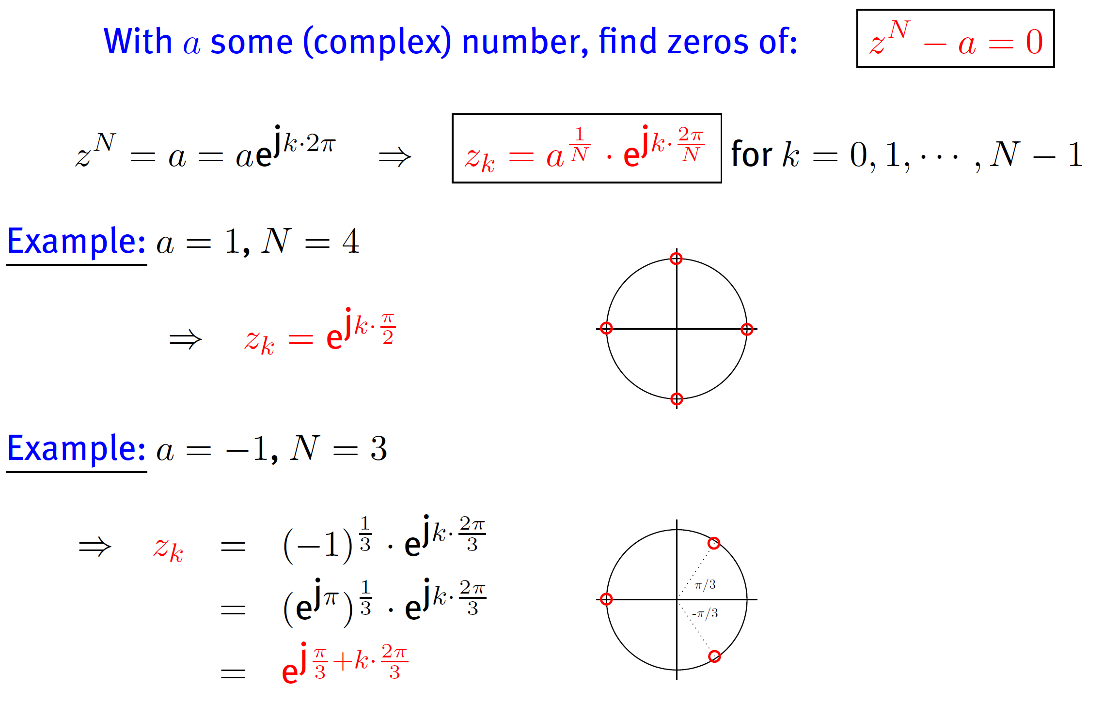
Pre-knowledge: Zeros of a complex equation
Course Introduction

Slide 11
Signals and Systems: An overview (ch.1)
Continuous-Time and Discrete-Time Signals
Transformations of the Independent Variable
Exponential and Sinusoidal Signals
The Unit Impulse and Unit Step Functions
Continuous-Time and Discrete-Time Systems
Basic System Properties
Continuous-Time and Discrete-Time Signals
Transformations of the Independent Variable
Exponential and Sinusoidal Signals
The Unit Impulse and Unit Step Functions
Continuous-Time and Discrete-Time Systems
Basic System Properties

Slide 12
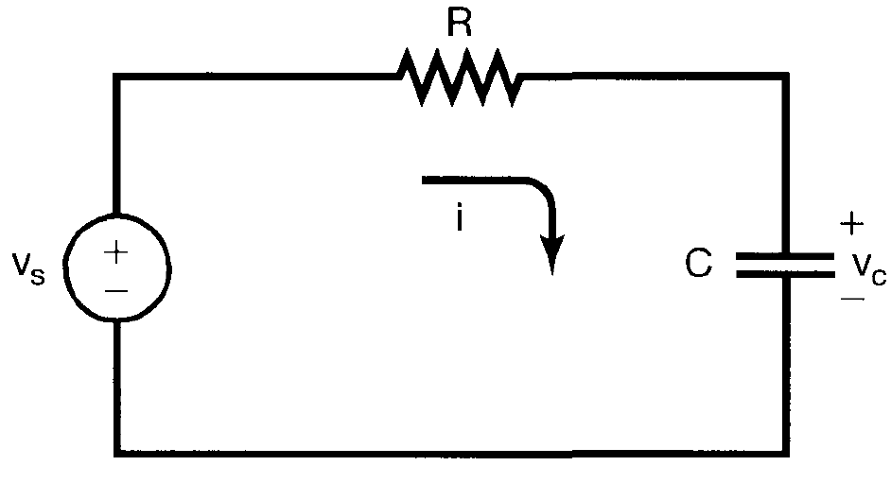
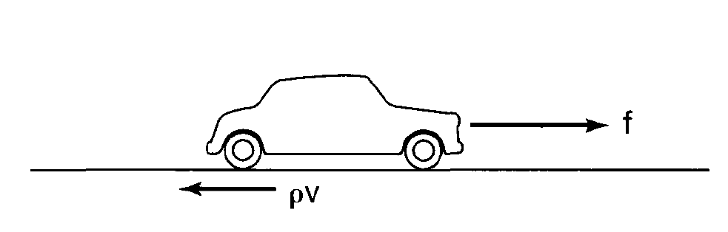
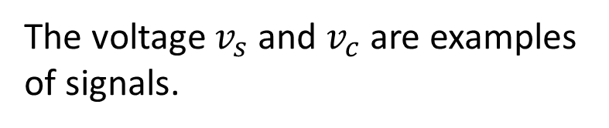
Continuous-Time and Discrete-Time Signals
Signals describe a wide variety of physical phenomena
The voltage $v_{s}$ and $v_{c}$ are examples of signals.
The force f and velocity v are signals.

Slide 13
Continuous-Time and Discrete-Time Signals
Mathematically, signals are represented as functions of one or more independent variables.
Example of typical signals
Sound
Image
Video

Slide 14
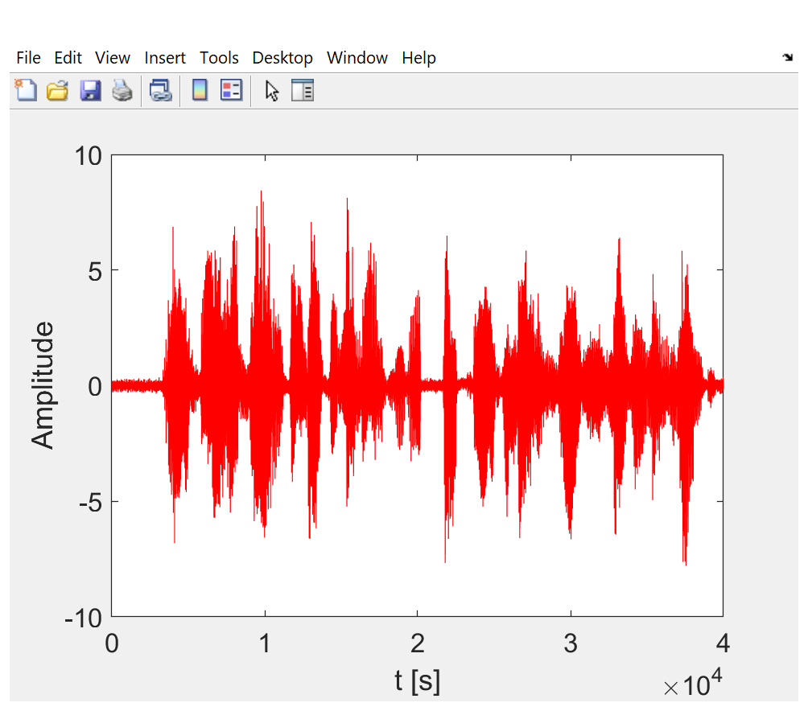

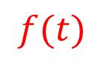
Continuous-Time and Discrete-Time Signals
Sound: represents acoustic pressure as a function of time
$$f(t)$$

Slide 15
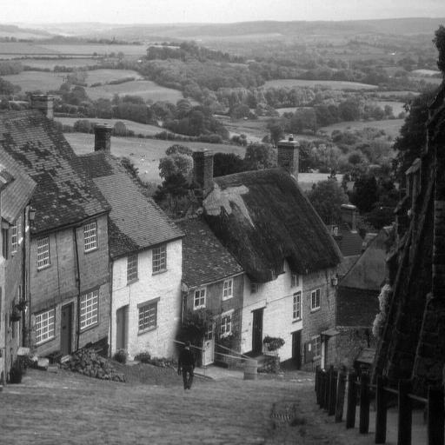
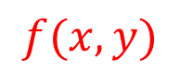
Continuous-Time and Discrete-Time Signals
Picture: represents brightness as a function of two spatial variables
$$f(x,y)$$

Slide 16
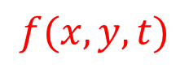
Continuous-Time and Discrete-Time Signals
Video: consists of a sequence of images, called frames, and is a function of 3 variables: 2 spatial coordinates and time
$$f(x,y,t)$$

Slide 17
Continuous-Time and Discrete-Time Signals
Independent variables can be one or more
Focus on signals involving a single independent variable
Generally refer to the independent variable as time, although it may not in fact represent time in specific applications
Continues-time and discrete-time signal

Slide 18
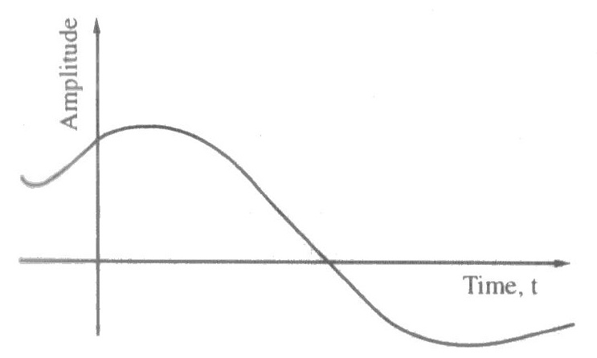
Continuous-Time and Discrete-Time Signals
Continues-time signals: the independent variable is continuous, and signals are defined for a continuum of values

Slide 19
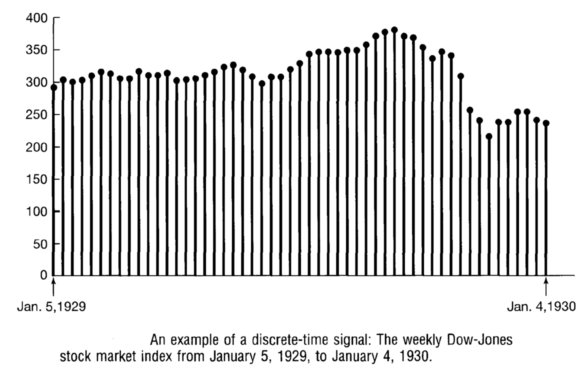
Continuous-Time and Discrete-Time Signals
Discrete-time signals: defined only at discrete times, and the independent variable takes on only a discrete set of values

Slide 20
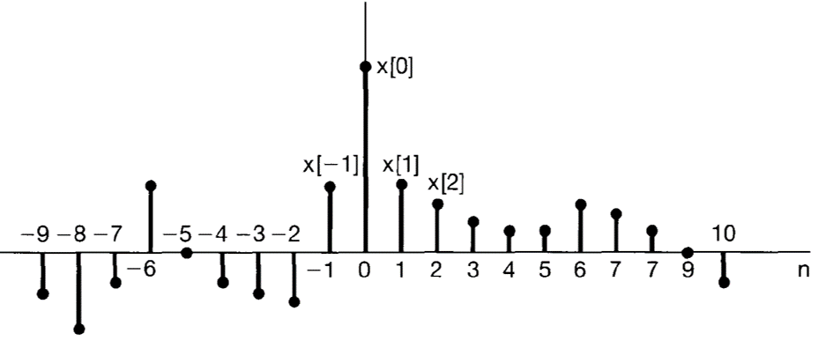
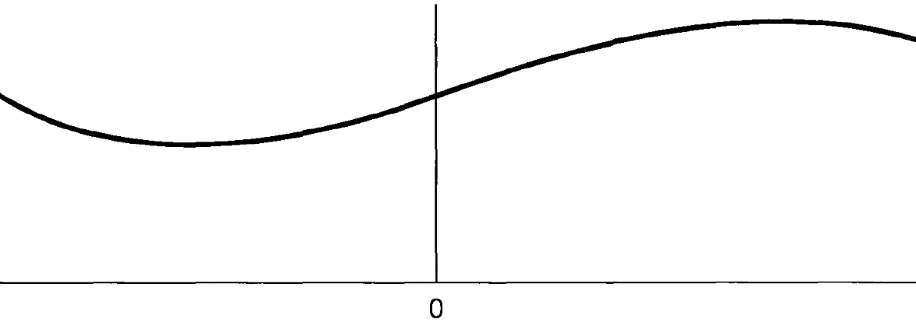
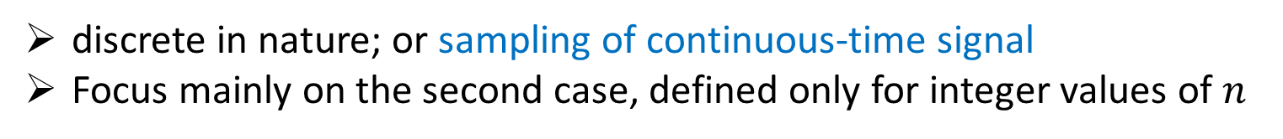
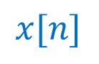
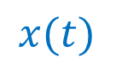
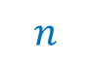
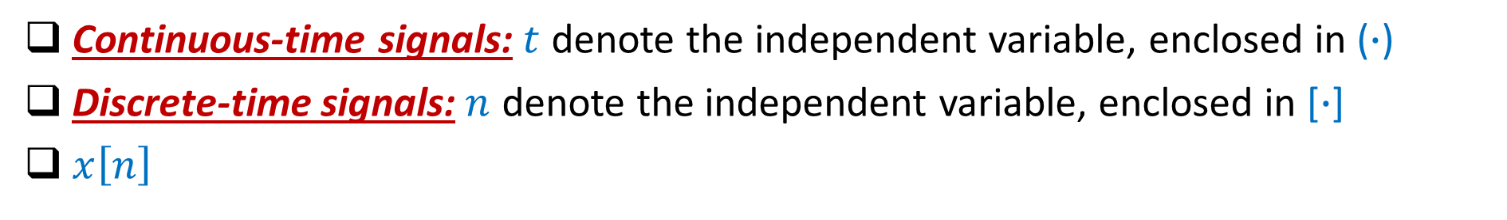

Continuous-Time and Discrete-Time Signals
Continuous-time signals:$t$ denote the independent variable, enclosed in ($∙$)
Discrete-time signals:$n$ denote the independent variable, enclosed in [$∙$]
$x\left[n\right]$
discrete in nature; or sampling of continuous-time signal
Focus mainly on the second case, defined only for integer values of $n$
$$x[n]$$
$$x(t)$$
$$t$$
$$n$$

Slide 21
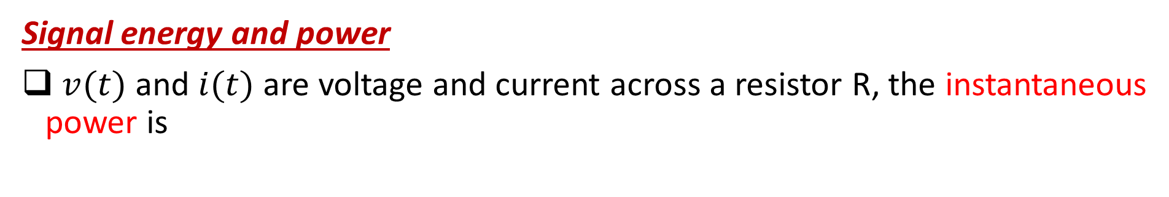
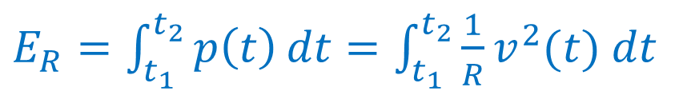
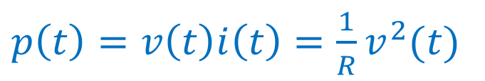
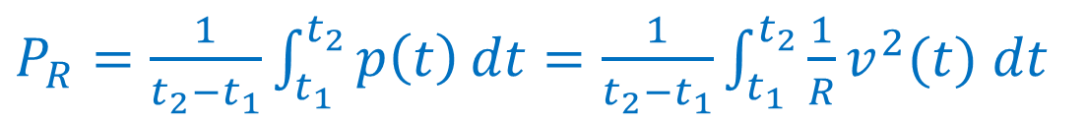
Continuous-Time and Discrete-Time Signals
Signal energy and power
$v(t)$ and $i(t)$ are voltage and current across a resistor R, the instantaneous power is
$p\left(t\right)=v\left(t\right)i\left(t\right)=\frac{1}{R}v^{2}(t)$
The total energy over the time interval $t_{1}≤t≤t_{2}$ is
$E_{R}=\int_{t_{1}}^{t_{2}}{p\left(t\right)}dt=\int_{t_{1}}^{t_{2}}{\frac{1}{R}v^{2}(t)}$ $dt$
The average power over the time interval $t_{1}≤t≤t_{2}$ is
$P_{R}=\frac{1}{t_{2}−t_{1}}\int_{t_{1}}^{t_{2}}{p\left(t\right)}dt=\frac{1}{t_{2}−t_{1}}\int_{t_{1}}^{t_{2}}{\frac{1}{R}v^{2}(t)}$ $dt$

Slide 22
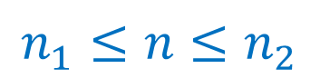
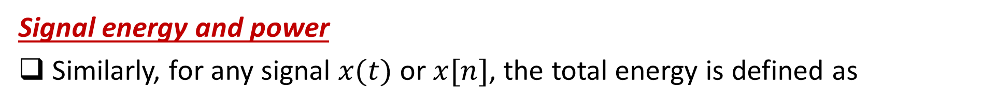
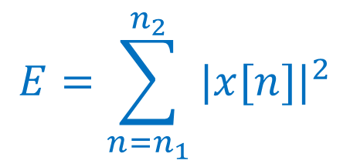
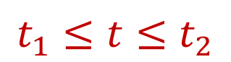
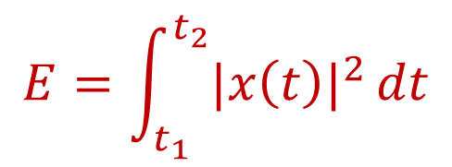
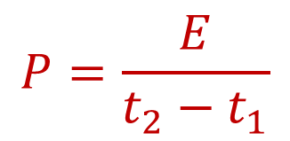
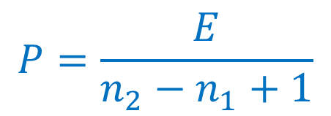
Continuous-Time and Discrete-Time Signals
Signal energy and power
Similarly, for any signal $x(t)$ or $x[n]$, the total energy is defined as
$$E=\int_{t_{1}}^{t_{2}}{{|x\left(t\right)|}^{2}}dt$$
$$t_{1}≤t≤t_{2}$$
Continuous-time signal
$$E=\sum_{n=n_{1}}^{n_{2}}{{|x[n]|}^{2}}$$
$$n_{1}≤n≤n_{2}$$
Discrete-time signal
The average power is defined as
$$P=\frac{E}{t_{2}−t_{1}}$$
$$P=\frac{E}{n_{2}−n_{1}+1}$$
Continuous
Discrete

Slide 23
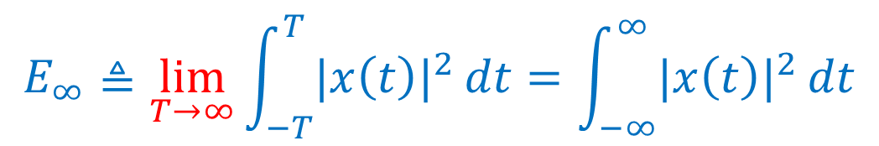
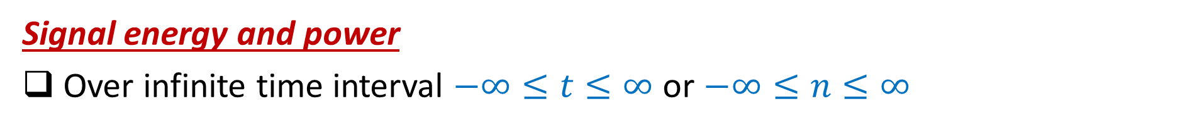
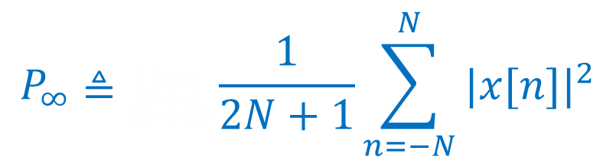
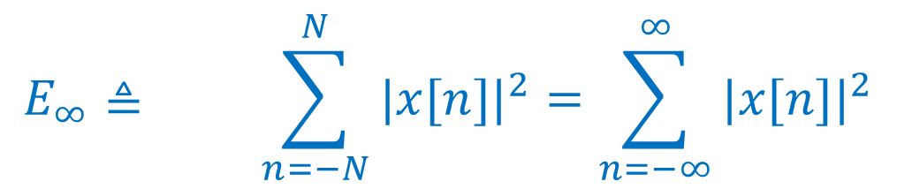
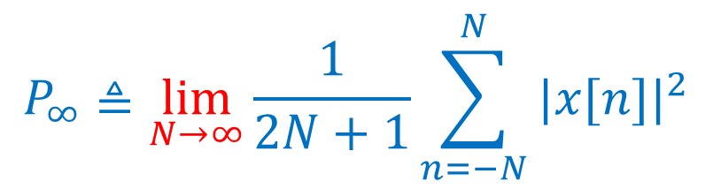
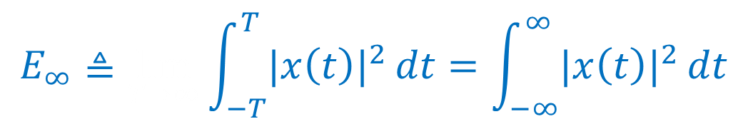
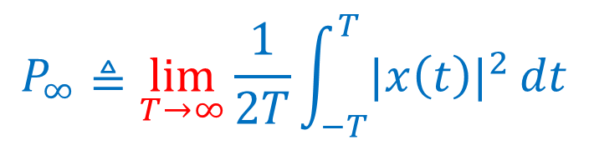
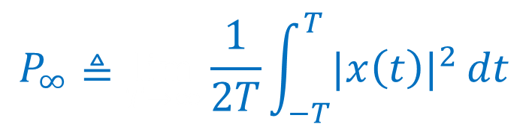
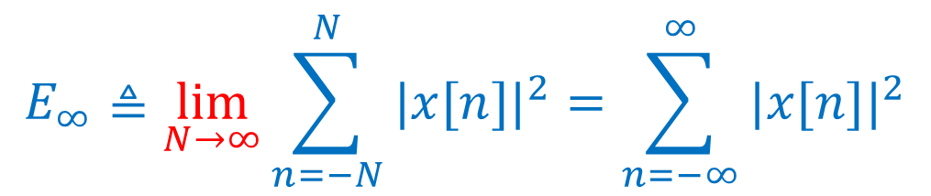
Continuous-Time and Discrete-Time Signals
Signal energy and power
Over infinite time interval $−∞≤t≤∞$ or $−∞≤n≤∞$
$$E_{∞}≜\lim_{T→∞}{\int_{−T}^{T}{{|x\left(t\right)|}^{2}}dt=\int_{−∞}^{∞}{{|x\left(t\right)|}^{2}}dt}$$
$$E_{∞}≜\lim_{T→∞}{\int_{−T}^{T}{{|x\left(t\right)|}^{2}}dt=\int_{−∞}^{∞}{{|x\left(t\right)|}^{2}}dt}$$
Continuous
$$E_{∞}≜\lim_{N→∞}\sum_{n=−N}^{N}{{|x[n]|}^{2}}=\sum_{n=−∞}^{∞}{{|x[n]|}^{2}}$$
$$E_{∞}≜\lim_{N→∞}\sum_{n=−N}^{N}{{|x[n]|}^{2}}=\sum_{n=−∞}^{∞}{{|x[n]|}^{2}}$$
Discrete
$$P_{∞}≜\lim_{N→∞}\frac{1}{2N+1}\sum_{n=−N}^{N}{{|x[n]|}^{2}}$$
$$P_{∞}≜\lim_{T→∞}\frac{1}{2T}{\int_{−T}^{T}{{|x\left(t\right)|}^{2}}dt}$$
$$P_{∞}≜\lim_{N→∞}\frac{1}{2N+1}\sum_{n=−N}^{N}{{|x[n]|}^{2}}$$
$$P_{∞}≜\lim_{T→∞}\frac{1}{2T}{\int_{−T}^{T}{{|x\left(t\right)|}^{2}}dt}$$
Continuous
Discrete

Slide 24
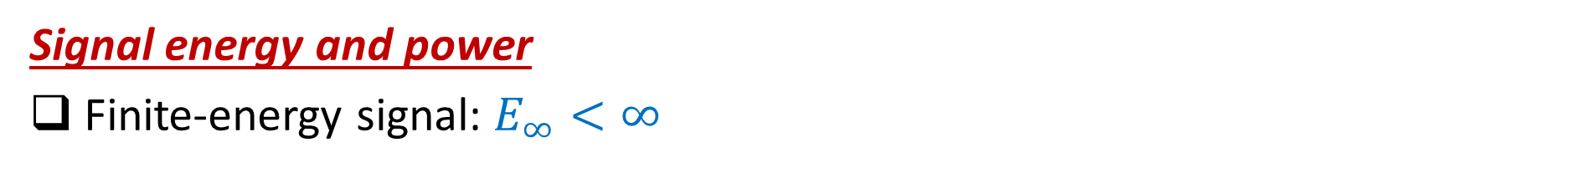

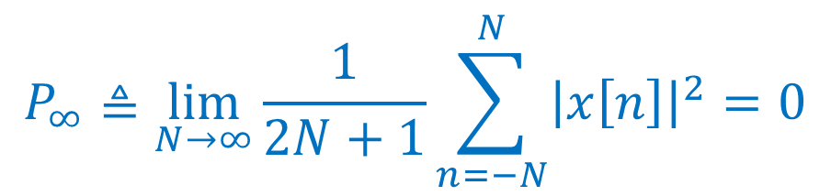

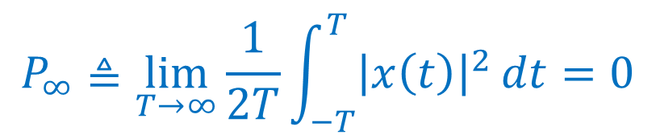
Continuous-Time and Discrete-Time Signals
Signal energy and power
Finite-energy signal: $E_{∞}<∞$
$$P_{∞}≜\lim_{T→∞}\frac{1}{2T}{\int_{−T}^{T}{{\left|x\left(t\right)\right|}^{2}}dt}=0$$
$$P_{∞}≜\lim_{N→∞}\frac{1}{2N+1}\sum_{n=−N}^{N}{{\left|x\left[n\right]\right|}^{2}}=0$$
Finite-power signal: $P_{∞}<∞$, $E_{∞}=∞$
Infinite energy & power signal $P_{∞}→∞$, $E_{∞}→∞$

Slide 25
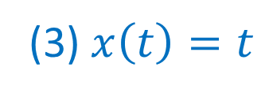
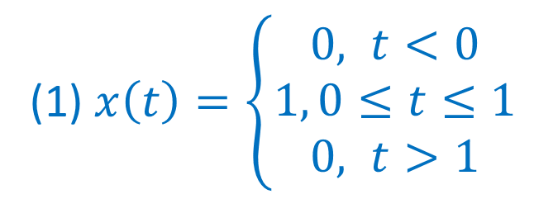
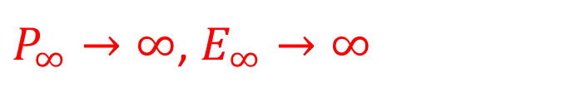
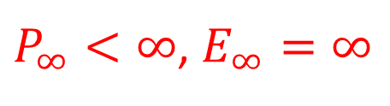
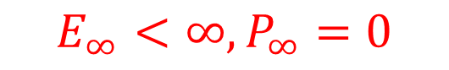


Continuous-Time and Discrete-Time Signals
Signal energy and power
Examples: $E_{∞}<∞$
(1) $x\left(t\right)=\left\{\begin{matrix}0, t<0 \\ 1, 0≤t≤1 \\ 0, t>1\end{matrix}\right.$
$$E_{∞}<∞,P_{∞}=0$$
(2) $x[n]=4$
$P_{∞}<∞$, $E_{∞}=∞$
(3) $x\left(t\right)=t$
$P_{∞}→∞$, $E_{∞}→∞$
Notes:
Questions: energy infinite or power infinite?

Slide 26
Signals and Systems: An overview (ch.1)
Continuous-Time and Discrete-Time Signals
Transformations of the Independent Variable
Exponential and Sinusoidal Signals
The Unit Impulse and Unit Step Functions
Continuous-Time and Discrete-Time Systems
Basic System Properties

Slide 27











Transformation of the independent variable
Time shift
$$t_{0}>0$$
$$x\left(t\right)$$
$$x\left(t−t_{0}\right)$$
$$∙$$
$$∙$$
$x\left(t\right)$: $\left\{t=a\right\}→\{x\left(t\right)=x\left(a\right)\}$
$x\left(t−t_{0}\right)$:$\left\{t=?\right\}→\{x\left(t−t_{0}\right)=x\left(a\right)\}$
$$n_{0}<0$$
$$x[n]$$
$$x[n−n_{0}]$$

Slide 28









Transformation of the independent variable
Time reversal
$$x[n]$$
$$x[−n]$$
$$x\left(t\right)$$
$$x\left(−t\right)$$
$$x\left(1−t\right)$$

Slide 29










Transformation of the independent variable
Time scaling
$$x\left(t\right)$$
$$x\left(2t\right)$$
Compressed
$$x\left(t\right)$$
$$x\left(t/2\right)$$
Stretched
$$x\left(t\right)$$
$$x\left(2t\right)$$
$$x\left(t/2\right)$$

Slide 30



Transformation of the independent variable
General: Let $x(t)→x(αt+β)$
if $\left|α\right|>1$, compressed
if $\left|α\right|<1$, stretched
if $α <0$, reversed
if $β ≠0$, shifted
Example1: Given the signal $x(t)$, to illustrate
$x(t+1)$
$x(−t+1)$
$x(3t/2)$
$x(\frac{3t}{2}+1)$

Slide 31





Transformation of the independent variable
$x(t+1)$ $x(−t+1)$ $x(3t/2)$ $x(\frac{3t}{2}+1)$

Slide 32

Transformation of the independent variable
Example2: A discrete signal x[n] is shown below, sketch and label following signals:
x[2n]
x[2n+1]

Slide 33


Transformation of the independent variable

Slide 34


Transformation of the independent variable
Periodic Signals
Continuous-time: $x\left(t\right)=x(t+T)$ for all t
Fundamental period
The smallest positive value of T for which $x\left(t\right)=x(t+T)$ holds

Slide 35


Transformation of the independent variable
Periodic Signals
Discrete-time: $x[n]=x[n+N]$ for all $n$
Fundamental period
The smallest positive value of N for which $x[n]=x[n+N]$ holds

Slide 36


Transformation of the independent variable
Periodic Signals
Example:

Slide 37



Even and Odd Signals
Transformation of the independent variable
Even signal
$x\left(t\right)=x(−t)$ $x[n]=x[−n]$
Odd signal
$x\left(t\right)=−x(−t)$ $x\left[n\right]=−x[−n]$

Slide 38
Even and Odd Signals
Transformation of the independent variable
Any signal can be broken into a sum of two signals
One even and one odd

Slide 39



Even and Odd Signals
Transformation of the independent variable
+

Slide 40









Even and Odd Signals
Transformation of the independent variable
$x\left[n\right]=x_{e}[n]$+$x_{o}[n]$
$$x_{e}[n]\text{=} (x\left[n\right]+x\left[−n\right])/2$$
$$x_{o}[n]\text{=} (x\left[n\right]−x\left[−n\right])/2$$
$$x\left[n\right]$$
$$x_{e}[n]$$
$$x_{o}[n]$$
+

Slide 41
Signals and Systems: An overview (ch.1)
Continuous-Time and Discrete-Time Signals
Transformations of the Independent Variable
Exponential and Sinusoidal Signals
The Unit Impulse and Unit Step Functions
Continuous-Time and Discrete-Time Systems
Basic System Properties

Slide 42



Continuous-Time Complex Exponential and Sinusoidal Signals
Exponential and Sinusoidal Signals
General case
C and a are complex number
a>0
Real exponential signal
C and a are real
a>0, as t↑, |x(t)| ↑
a<0, as t↑, |x(t)| ↓
a=0, |x(t)| is constant
t
a<0
t

Slide 43





Continuous-Time Complex Exponential and Sinusoidal Signals
Exponential and Sinusoidal Signals
Periodic exponential signals
c is real, specifically 1
a is purely imaginary
Fundamental period $T_{0}$?
$T_{0}$ is undefined for $ω_{0}=0$
$$x\left(t\right)=e^{jω_{0}t}$$
$$x\left(t\right)=e^{jω_{0}t}=e^{jω_{0}(t+T)}=e^{jω_{0}t}e^{jω_{0}T}$$
$$e^{jω_{0}T}=1$$
$$T=\frac{2kπ }{ω_{0}}$$
$$T_{o}=\frac{2π }{{|ω}_{0}|}$$
$ω_{0}T=2kπ$, $k=±1, ±2, …$

Slide 44


Exponential and Sinusoidal Signals
Continuous-Time Complex Exponential and Sinusoidal Signals
Sinusoidal Signals
Closely related to complex exponential signals
Fundamental frequency $ω_{0}$
$$x\left(t\right)=\operatorname{Acos}{(ω_{0}t+∅})$$
$$e^{j{(ω}_{0}t+∅)}=\cos{{(ω}_{0}t+∅)}+j\sin{{(ω}_{0}t+∅)}$$
$$\operatorname{Acos}{(ω_{0}t+∅})=A∙Re\{e^{j(ω_{0}t+∅)}\}$$
$$A\sin{(ω_{0}t+∅)}=A∙Im\{e^{j(ω_{0}t+∅)}\}$$

Slide 45








Exponential and Sinusoidal Signals
Continuous-Time Complex Exponential and Sinusoidal Signals
Sinusoidal Signals
Fundamental frequency $ω_{0}$
$$x\left(t\right)=\operatorname{Acos}{(ω_{0}t+∅})$$
$${ω_{3}<ω_{2}<ω}_{1}$$
$${T_{3}>T_{2}>T}_{1}$$

Slide 46


Exponential and Sinusoidal Signals
Continuous-Time Complex Exponential and Sinusoidal Signals
$e^{jω_{0}t}$ and $\operatorname{Acos}{(ω_{0}t+∅)}$ examples of signals with infinite total energy but finite average power
Total energy: infinite
Average power: finite

Slide 47

Exponential and Sinusoidal Signals
Continuous-Time Complex Exponential and Sinusoidal Signals
Harmonically related complex exponentials
Sets of periodic exponentials (with different frequencies), all of which are periodic with a common period $T_{0}$
$$e^{jωt}=e^{jω(t+T_{0})}=e^{jωt}e^{jωT_{0}}$$
$ωT_{0}=2kπ$, $k=0, ±1, ±2, ….$
$ω=2kπ/T_{0}{=kω}_{0}$, with $ω_{0}=2π/T_{0}$
$∅_{k}\left(t\right)=e^{j{kω}_{0}t}$, $k=0, ±1, ±2, …$ is a harmonically related set.
For any $k≠0$, fundamental frequency ${|k|ω}_{0}$; fundamental period
$\frac{2π}{{|k|ω}_{0}}=\frac{T_{0}}{|k|}$

Slide 48








Exponential and Sinusoidal Signals
Continuous-Time Complex Exponential and Sinusoidal Signals
Examples – Periodic or not?
Aperiodic

Slide 49






Continuous-Time Complex Exponential and Sinusoidal Signals
Exponential and Sinusoidal Signals
General case
$x\left(t\right)=|C|e^{rt}\cos{(ω_{0}t+θ)}$, $r>0$
$$x\left(t\right)=Ce^{at}$$
C and a are complex numbers
$C=|C|e^{jθ}$, $a=r+jω_{0}$
$$Ce^{at}=\left|C\right|e^{jθ}e^{\left(r+jω_{0}\right)t}=\left|C\right|e^{rt}e^{j\left(ω_{0}t+θ\right)}$$
$x\left(t\right)=|C|e^{rt}\cos{(ω_{0}t+θ)}$, $r<0$
$$Ce^{at}=\left|C\right|e^{rt}\cos{(ω_{0}t+θ)}+j\left|C\right|e^{rt}\sin{(ω_{0}t+θ)}$$
Notes:
Errors in previous version

Slide 50











Discrete-Time Complex Exponential and Sinusoidal Signals
Exponential and Sinusoidal Signals
General case
$$x\left[n\right]=Cα^{n}$$
$Cα^{n}$, -1$\text{<}α$<0
c and $α$ are complex numbers
$$x\left[n\right]=Ce^{βn}$$
$${α=e}^{β}$$
Real Exponential Signals
C and $α$ are real numbers
$Cα^{n}$, $α$<-1
$Cα^{n}$, $α$>1
$Cα^{n}$, $0\text{<}α$<1

Slide 51





Discrete-Time Complex Exponential and Sinusoidal Signals
Exponential and Sinusoidal Signals
Sinusoidal signals
c is real, specifically 1; $β$ is purely imaginary
Infinite total energy but finite average power
$$x\left[n\right]=e^{jω_{0}n}$$
Closely related
$$x\left[n\right]=A\cos{(ω_{0}n+∅)}$$
$$e^{jω_{0}n}=\cos{ω_{0}n}+j\sin{ω_{0}n}$$
$$A\cos{(ω_{0}n+∅)}=A/2∙e^{j∅}e^{jω_{0}n}+A/2∙e^{−j∅}e^{−jω_{0}n}$$
$$A\cos{(ω_{0}n+∅)}=A∙Re{\{e}^{j\left(ω_{0}n+∅\right)}\}$$
$$A\sin{(ω_{0}n+∅)}=A∙Im{\{e}^{j\left(ω_{0}n+∅\right)}\}$$
$${|e^{jω_{0}n}|}^{2}=1$$

Slide 52






General Signals
Exponential and Sinusoidal Signals
Discrete-Time Complex Exponential and Sinusoidal Signals
$\left|C\right|{\left|α\right|}^{n}\cos{(ω_{0}n+θ)}$, $\left|α\right|>1$
$$x\left[n\right]=Cα^{n}$$
$C={|C|e}^{jθ}$, $α=|α|e^{jω_{0}}$
$\left|C\right|{\left|α\right|}^{n}\cos{(ω_{0}n+θ)}$, $\left|α\right|<1$
$$x\left[n\right]=\left|C\right|{\left|α\right|}^{n}\cos{(ω_{0}n+θ)}$$
$$+j\left|C\right|{\left|α\right|}^{n}sin{ω_{0}n+θ}$$

Slide 53



Exponential and Sinusoidal Signals
Discrete-Time Complex Exponential and Sinusoidal Signals
Periodicity properties
$$x\left[n\right]=e^{jω_{0}n}$$
$ω_{0}$, same value at $ω_{0}$ and $ω_{0}+2kπ$
Only consider interval $0{≤ω}_{0}≤2π$ or $−π{≤ω}_{0}≤π$
From 0 to $π$: $ω_{0}↑$, oscillation rate of $e^{jω_{0}n}↑$
From $π$ to $2π$: $ω_{0}↑$, oscillation rate of $e^{jω_{0}n}↓$
Maximum oscillation rate at $ω_{0}=π$
$$e^{j{(ω}_{0}+2kπ)n}=e^{j2kπn}e^{jω_{0}n}=e^{jω_{0}n}$$
$$e^{jπn}={{(e}^{jπ})}^{n}={(−1) }^{n}$$

Slide 54





Exponential and Sinusoidal Signals
Discrete-Time Complex Exponential and Sinusoidal Signals
Periodicity properties
Q: Which one is a higher frequency signal?
$$ω_{0}=π$$
$$ω_{0}=3π/2$$
$$N=2$$
$$N=4$$

Slide 55









Exponential and Sinusoidal Signals
Discrete-Time Complex Exponential and Sinusoidal Signals
Periodicity properties
$$ω_{0}=0$$
$$\cos{(ω_{0}n)}$$
$$ω_{0}=π/8$$
$$ω_{0}=π/4$$
$$ω_{0}=π$$

Slide 56



Exponential and Sinusoidal Signals
Discrete-Time Complex Exponential and Sinusoidal Signals
Periodicity properties
$$ω_{0}=2π$$
$$\cos{(ω_{0}n)}$$
$$ω_{0}=15π/8$$
$$ω_{0}=7π/4$$
$$ω_{0}=π$$

Slide 57



Exponential and Sinusoidal Signals
Discrete-Time Complex Exponential and Sinusoidal Signals
Periodicity properties
$$x\left[n\right]=e^{jω_{0}n}$$
In order for $e^{jω_{0}n}$ to be periodic with N>0, must
$ω_{0}/2π$: rational number
Fundamental frequency: $2π/N=ω_{0}/m$
Fundamental period: $N=m(2π/ω_{0})$
$$e^{jω_{0}(n+N)}=e^{jω_{0}N}e^{jω_{0}n}=e^{jω_{0}n}$$
$ω_{0}N=2πm$, $m$ integer number
$$\frac{ω_{0}}{2π}=\frac{m}{N}$$

Slide 58

Exponential and Sinusoidal Signals
Discrete-Time Complex Exponential and Sinusoidal Signals
Periodicity properties
$x[n]=\cos{(2πn/12)}$ periodic N=12
$x[n]=\cos{(8πn/31)}$ periodic N=31
$x[n]=\cos{(n/6)}$ aperiodic
$x\left[n\right]=e^{j\left(\frac{2πn}{3}\right)}+e^{j(\frac{3πn}{4})}$ periodic, N=24

Slide 59


Periodicity properties: discrete-time vs. continuous-time
Exponential and Sinusoidal Signals
$$e^{jω_{0}t}$$
$$e^{jω_{0}n}$$
Identical signals for
values of ω₀ separated
by multiples of 2π
Distinct signals for
distinct ω₀
Only if ω₀=2πm/N for
some integers N>0 and m
Periodic for any ω₀
Fundamental
frequency ω₀
ω₀ ⁄ m
Fundamental
period 2π/ ω₀
N=m(2π/ ω₀)

Slide 60
Signals and Systems: An overview (ch.1)
Continuous-Time and Discrete-Time Signals
Transformations of the Independent Variable
Exponential and Sinusoidal Signals
The Unit Impulse and Unit Step Functions
Continuous-Time and Discrete-Time Systems
Basic System Properties

Slide 61





Discrete-time unit impulse and unit step sequences
The Unit Impulse and Unit Step Functions
Unit impulse (unit sample ) is defined as
Unit step is defined as

Slide 62





Discrete-time unit impulse and unit step sequences
The Unit Impulse and Unit Step Functions
The impulse is the first difference of the step
Conversely, the step is the running sum of unit sample
$$n<0$$
$$n>0$$

Slide 63






Discrete-time unit impulse and unit step sequences
The Unit Impulse and Unit Step Functions
Let $m=n−k$,
$$n<0$$
$$n>0$$

Slide 64


Discrete-time unit impulse and unit step sequences
The Unit Impulse and Unit Step Functions
Sampling property
More generally

Slide 65




Continuous-time unit impulse and unit step sequences
The Unit Impulse and Unit Step Functions
Unit step
The continuous unit step u(t) is the running integral of unit impulse δ(t)
δ(t) the first derivative of u(t)

Slide 66












Continuous-time unit impulse and unit step sequences
The Unit Impulse and Unit Step Functions
$u(t)$ is discontinuous at $t=0$, How we get $δ(t)$?
Consider $u_{∆}(t)$
$$u_{∆}(t)$$
$$t$$
$$t$$
$$t$$
$$δ_{∆}\left(t\right)=\frac{d u_{∆}(t) }{dt}$$
$$δ\left(t\right)=\lim_{∆→0}{δ_{∆}(t)}$$
$$u\left(t\right)=\lim_{∆→0}{u_{∆}(t)}$$
arrow at $t=0$: area of the pulse is concentrated at $t=0$
arrow height and "1“: area of the impulse

Slide 67









Continuous-time unit impulse and unit step sequences
The Unit Impulse and Unit Step Functions
$$u\left(t\right)=\int_{−∞}^{t}{δ\left(τ\right)dτ}$$
$$u\left(t\right)=\int_{0}^{∞}{δ\left(t−σ\right)dσ}$$
Let $σ=t−τ$
$$t<0$$
$$t<0$$
$$t>0$$
$$t>0$$

Slide 68




Continuous-time unit impulse and unit step sequences
The Unit Impulse and Unit Step Functions
Sampling property
More generally
$$x_{1}\left(t\right)=x(t)δ_{∆} \left(t\right)$$
$$x(t)δ_{∆} \left(t\right)≈x(0)δ_{∆} \left(t\right)$$
$$x(t)δ\left(t\right)=\lim_{∆→0}{x(t)δ_{∆} \left(t\right)}=x(0)δ\left(t\right)$$
$$x(t)δ\left(t−t_{0}\right)=x(t_{0})δ\left(t\right)$$

Slide 69


Continuous-time unit impulse and unit step sequences
The Unit Impulse and Unit Step Functions
Example:
(1) Calculate and sketch the x’(t);
(2) Recover x(t) from x’(t).
Solutions:

Slide 70
Signals and Systems: An overview (ch.1)
Continuous-Time and Discrete-Time Signals
Transformations of the Independent Variable
Exponential and Sinusoidal Signals
The Unit Impulse and Unit Step Functions
Continuous-Time and Discrete-Time Systems
Basic System Properties

Slide 71

Continuous-Time and Discrete-Time Systems
Continuous-Time Systems: Input and output are continuous
Discrete-Time Systems: Input and output are discrete

Slide 72

Continuous-Time and Discrete-Time Systems
Examples of systems
RC circuit

Slide 73


Continuous-Time and Discrete-Time Systems
Examples of systems
Moving car
In general:

Slide 74


Continuous-Time and Discrete-Time Systems
Examples of systems
Balance in a bank account:
$y[n]$: balance at the end of the nth month; $x[n]$: net deposit; Interest rate: 1%

Slide 75




Continuous-Time and Discrete-Time Systems
Examples of systems
Digital simulation a differential equation
Approximate $dv(t)/dt$ at $t=n∆$ by $\frac{v\left(n∆\right)−v((n−1)∆)}{∆}$
$$\frac{v\left(n∆\right)−v((n−1)∆)}{∆}+\frac{ρ}{m}v\left(n∆\right)=\frac{1}{m}f(n∆)$$
$$v\left[n\right]−\frac{m}{m+ρ∆}v\left[n−1\right]=\frac{1}{m+ρ∆}f[n]$$
Let $v\left[n\right]=v\left(n∆\right)$
In general
$$y\left[n\right]+ay\left[n−1\right]=bx[n]$$

Slide 76


Continuous-Time and Discrete-Time Systems
Interconnections of systems
Series (or cascade)
Parallel
Feedback

Slide 77
Signals and Systems: An overview (ch.1)
Continuous-Time and Discrete-Time Signals
Transformations of the Independent Variable
Exponential and Sinusoidal Signals
The Unit Impulse and Unit Step Functions
Continuous-Time and Discrete-Time Systems
Basic System Properties

Slide 78

System with and without memory
Basic System Properties
System without memory:
Output is dependent only on the current input
Examples:

Slide 79

System with and without memory
Basic System Properties
System with memory:
Output is dependent on the current and previous inputs
Examples:
Memory: retaining or storing information about input values at times
Physical systems, memory is associated with the storage of energy

Slide 80



Invertibility and inverse system
Basic System Properties
Invertible
Distinct inputs lead to distinct outputs.

Slide 81



Invertibility and inverse system
Basic System Properties
Invertible
Accumulator
Examples:
The difference between two successive outputs is precisely the inputs

Slide 82

Invertibility and inverse system
Basic System Properties
Noninvertible
All x[n] leads to the same y[n]
Cannot determine the sign of the inputs

Slide 83

Causality
Basic System Properties
Causal: the output at any time depends only on the inputs at the present time and in the past
Causal
Causal
Causal
Non-causal
Non-causal

Slide 84


Causality
Basic System Properties
Examples
$$y[n]=x[−n]$$
Non-causal
$$y\left(t\right)=x\left(t\right)\cos{(t+1)}$$
Causal

Slide 85

Stability
Basic System Properties
Informally: small inputs lead to responses that do not diverge.
Stable
A bank account balance
$$y\left[n\right]=x[n]+(1+α)×y\left[n−1\right]$$
Unstable
Unstable

Slide 86



Stability
Basic System Properties
Formally: bounded input leads to bounded output
Bounded: $\left|y\left(t\right)\right|<B$
Stable
Unstable

Slide 87


Stability
Basic System Properties
Examples
$$S_{1}:y(t)=tx\left(t\right)$$
Unstable
$$S_{2}:y(t)=e^{x\left(t\right)}$$
Stable
$\left|x\left(t\right)\right|<B → −B<x\left(t\right)<B$ $→ e^{−B}<y\left(t\right)<e^{B}$

Slide 88










Time Invariance
Basic System Properties
Time invariant: a time shift in the input signal results in an identical time shift in the output signal
$$x_{1} (t)$$
System
$$y_{1} (t)$$
If
Then
System
$$y_{2} (t)$$
$$x_{2} \left(t\right)$$
If
If $x_{2} \left(t\right)=x_{1} (t−t_{0})$
$$y_{2} \left(t\right)=f\left\{x_{2}\left(t\right)\right\}$$
Then
$${y_{2}^{′}(t)=y}_{1} \left(t−t_{0}\right)$$
$$y_{2} \left(t\right)=y_{2}^{′}\left(t\right) ?$$

Slide 89














Time Invariance
Basic System Properties
If $x_{2} \left(t\right)=x_{1} (t−t_{0})$
Examples: $y \left(t\right)=\sin{[x(t)]}$
$$y_{2} \left(t\right)=f\left\{x_{2}\left(t\right)\right\}$$
$$f\left\{∙\right\}=sin\{∙\}$$
$$x_{1} (t)$$
$$\sin{[x(t)]}$$
$$y_{1} (t)$$
$$y_{2} \left(t\right)=\sin{[x_{1} \left(t−t_{0}\right)]}$$
$$x_{2} (t)$$
$$\sin{[x(t)]}$$
$$y_{2} (t)$$
$${y_{2}^{′}(t)=y}_{1} \left(t−t_{0}\right)$$
$$y_{1} \left(t\right)=\sin{[x_{1}(t)]}$$
$$y_{2}^{′}(t)=\sin{[x_{1} \left(t−t_{0}\right)]}$$
$$∴y_{2} \left(t\right)=y_{2}^{′}(t)$$

Slide 90












Time Invariance
Basic System Properties
Examples: $y \left[n\right]=nx[n]$
If $x_{2} \left[n\right]=x_{1} [n−n_{0}]$
$$y_{2} [n]=f\left\{x_{2}[n]\right\}$$
$$=n{∙x}_{1} [n−n_{0}]$$
$$x_{1} [n]$$
$$nx[n]$$
$$y_{1} [n]$$
$${y_{2}^{′}\left[n\right]=y}_{1} [n−n_{0}]$$
$$x_{2} [n]$$
$$nx[n]$$
$$y_{2} [n]$$
$$y_{1} [n]=n{∙x}_{1} [n]$$
$$y_{2}^{′}\left[n\right]=(n−n_{0}){∙x}_{1} [n{−n}_{0}]$$
$$∴y_{2} [n]≠y_{2}^{′}\left[n\right]$$

Slide 91









Time Invariance
Basic System Properties
Examples: $y \left(t\right)=x(2t)$
$$If x_{2} \left(t\right)=x_{1} (t−t_{0})$$
$$y_{2} \left(t\right)=f\left\{x_{2}\left(t\right)\right\}$$
$$x(2t)$$
$$y_{1} (t)$$
$$=x_{1} (2t−t_{0})$$
$$x_{1} (t)$$
$${y_{2}^{′}(t)=y}_{1} \left(t−t_{0}\right)$$
$$x_{2} (t)$$
$$x(2t)$$
$$y_{2} (t)$$
$$y_{1} \left(t\right)=x_{1}(2t)$$
$$y_{2}^{′}(t)=x_{1}[2\left(t−t_{0}\right)]$$
$$∴y_{2} \left(t\right)≠y_{2}^{′}(t)$$

Slide 92










Linearity
Basic System Properties
$$x_{1}\left(t\right)→y_{1}\left(t\right), x_{2}\left(t\right)→y_{2}\left(t\right)$$
Superposition property (additivity and homogeneity)
Linear
$$ax_{1}\left(t\right)+bx_{2}\left(t\right)→ay_{1}\left(t\right)+by_{2}\left(t\right)$$
System
$$y_{1} (t)$$
If $x_{3}\left(t\right)=ax_{1}\left(t\right)+bx_{2}\left(t\right)$
$$x_{1} (t)$$
$$y_{3} \left(t\right)=f\left\{x_{3}\left(t\right)\right\}$$
$$x_{2} (t)$$
System
$$y_{2} (t)$$
$$y_{3}^{′}(t)=ay_{1}\left(t\right)+by_{2}\left(t\right)$$
$$x_{3} (t)$$
System
$$y_{3} (t)$$
$$y_{3} \left(t\right)=y_{3}^{′}\left(t\right) ?$$

Slide 93















Linearity
Basic System Properties
$$y\left(t\right)=tx(t)$$
Examples
If $x_{3}\left(t\right)=ax_{1}\left(t\right)+bx_{2}\left(t\right)$
$$x_{1} (t)$$
$$y_{3} \left(t\right)=f\left\{x_{3}\left(t\right)\right\}$$
$$y_{1}\left(t\right)=tx_{1}(t)$$
$$tx(t)$$
$$=t[ax_{1}\left(t\right)+bx_{2}\left(t\right)]$$
$$x_{2} (t)$$
$$y_{2}\left(t\right)=tx_{2}(t)$$
$$tx(t)$$
$$y_{3}^{′}(t)=ay_{1}\left(t\right)+by_{2}\left(t\right)$$
$$x_{3} (t)$$
$$y_{3}\left(t\right)=tx_{3}(t)$$
$$tx(t)$$
$$y_{3}^{′}(t)=atx_{1}\left(t\right)+btx_{1}\left(t\right)$$
$$y_{3}\left(t\right)=y_{3}^{′}(t)$$

Slide 94












Linearity
Basic System Properties
$$y\left(t\right)=x^{2}(t)$$
If $x_{3}\left(t\right)=ax_{1}\left(t\right)+bx_{2}\left(t\right)$
Examples
$$y_{3} \left(t\right)=f\left\{x_{3}\left(t\right)\right\}$$
$$x_{1} (t)$$
$$y_{1}\left(t\right)=x_{1}^{2}(t)$$
$$x^{2}(t)$$
$$={[ax_{1}\left(t\right)+bx_{2}\left(t\right)] }^{2}$$
$$x_{2} (t)$$
$$y_{2}\left(t\right)=x_{2}^{2}(t)$$
$$x^{2}(t)$$
$$y_{3}^{′}(t)=ay_{1}\left(t\right)+by_{2}\left(t\right)$$
$$x_{3} (t)$$
$$y_{3}\left(t\right)=x_{3}^{2}(t)$$
$$=ax_{1}^{2}\left(t\right)+bx_{2}^{2}(t)$$
$$x^{2}(t)$$
$$y_{3}\left(t\right)≠y_{3}^{′}(t)$$

Slide 95
















Linearity
Basic System Properties
$$y[n]=Re\{x[n]\}$$
Examples
If $x_{3}\left[n\right]=ax_{1}\left[n\right]+bx_{2}\left[n\right]$
$$x_{1}[n]$$
$$y_{1}[n]=Re\{x_{1}[n]\}$$
$$y_{3}\left[n\right]=f\left\{x_{3}[n]\right\}$$
$$Re\{x[n]\}$$
$$=Re\{ax_{1}\left[n\right]+bx_{2}\left[n\right]\}$$
$$x_{2}[n]$$
$$y_{2}[n]=Re\{x_{2}[n]\}$$
$$Re\{x[n]\}$$
$$y_{3}^{′}[n]=ay_{1}\left[n\right]+by_{2}\left[n\right]$$
$$y_{3}[n]=Re\{x_{3}[n]\}$$
$$=aRe\{x_{1}[n]\}+bRe\{x_{2}[n]\}$$
$$x_{3}[n]$$
$$Re\{x[n]\}$$
If a and b are complex numbers
$$y_{3}[n]≠y_{3}^{′}[n]$$

Slide 96









Linearity
Basic System Properties
$$y\left[n\right]=2x\left[n\right]+3$$
Examples
If $x_{3}\left[n\right]=ax_{1}\left[n\right]+bx_{2}\left[n\right]$
$$x_{1}[n]$$
$$y_{1}[n]=2x_{1}\left[n\right]+3$$
$$y_{3}\left[n\right]=f\left\{x_{3}[n]\right\}$$
$$2x\left[n\right]+3$$
$$=2\left(ax_{1}\left[n\right]+bx_{2}\left[n\right]\right)+3$$
$$x_{2}[n]$$
$$y_{2}[n]=2x_{2}\left[n\right]+3$$
$$2x\left[n\right]+3$$
$$y_{3}^{′}[n]=ay_{1}\left[n\right]+by_{2}\left[n\right]$$
$$x_{3}[n]$$
$$y_{3}[n]=2x_{3}\left[n\right]+3$$
$$=a(2x_{1}\left[n\right]+3)+b(2x_{1}\left[n\right]+3)$$
$$2x\left[n\right]+3$$
$$y_{3}[n]≠y_{3}^{′}[n]$$

